Slide 1

Farm to Form Hackathon Funding and Networking
George Megas, H2020 National Expert, EIT Health Coordinator, Enterprise Europe Network Innovation & RnI programmes consultant

Slide 2
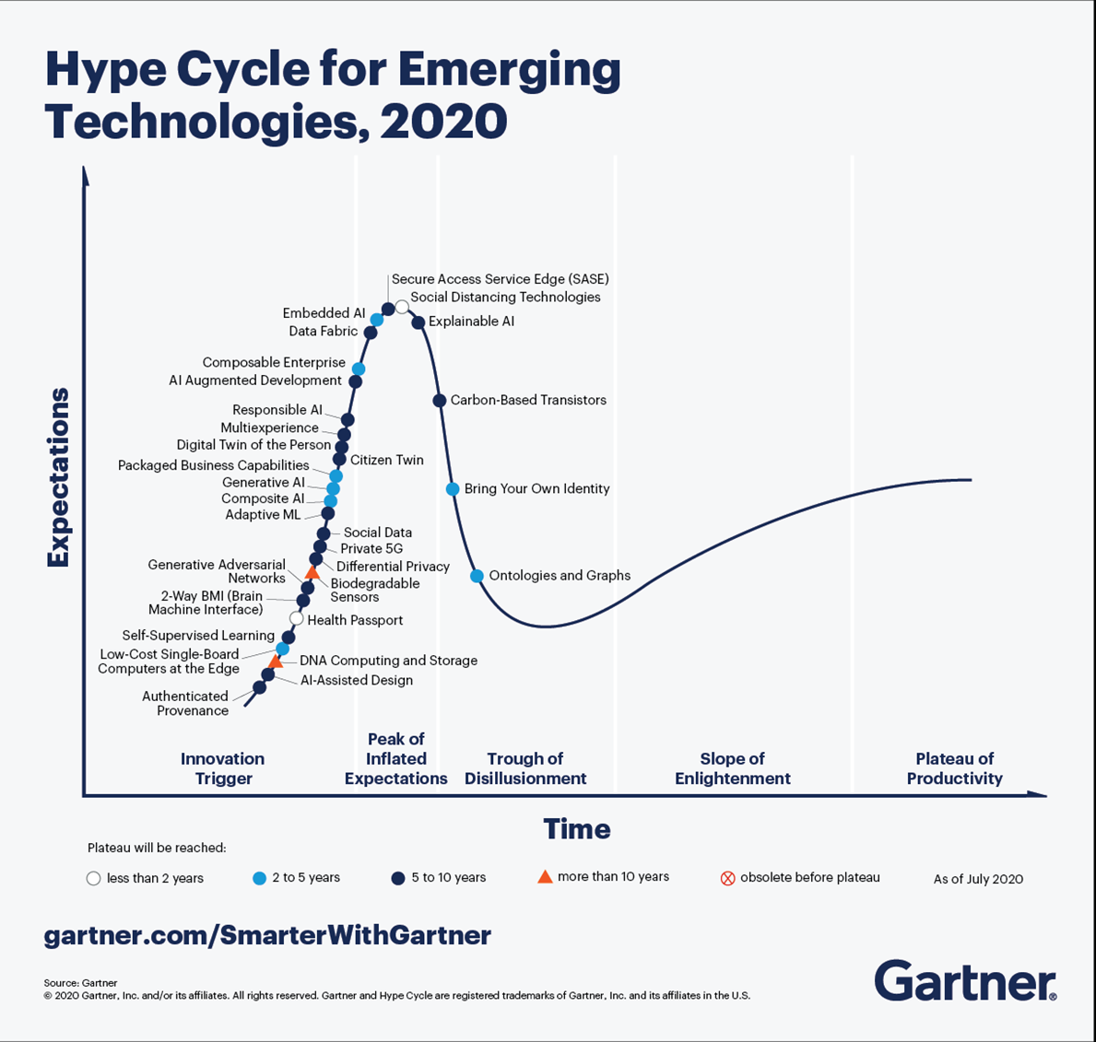
Composite architectures
composable enterprise
modular design enabling organizations to “recompose” if needed, like during a pandemic
2) Algorithmic trust
authenticated provenance
Authenticating assets on the blockchain ensuring they’re not fake
3) Beyond silicon
DNA computing and storage
data is encoded in synthetic DNA for storage & enzymes process it
4) Formative AI
generative AI,
AI that can create new novel content (images, video etc) can be used for Deep fake or Drug discovery
5) Digitalme:Brain-Maching interfaces/ ask Elon Musk

Slide 3

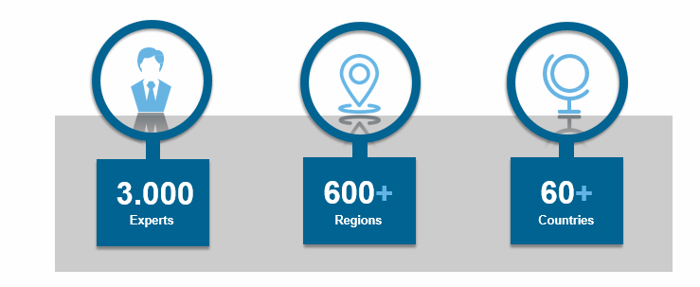
Enterprise Europe Network: The biggest Network in the world supporting the Internationalisation of SMEs

Slide 4
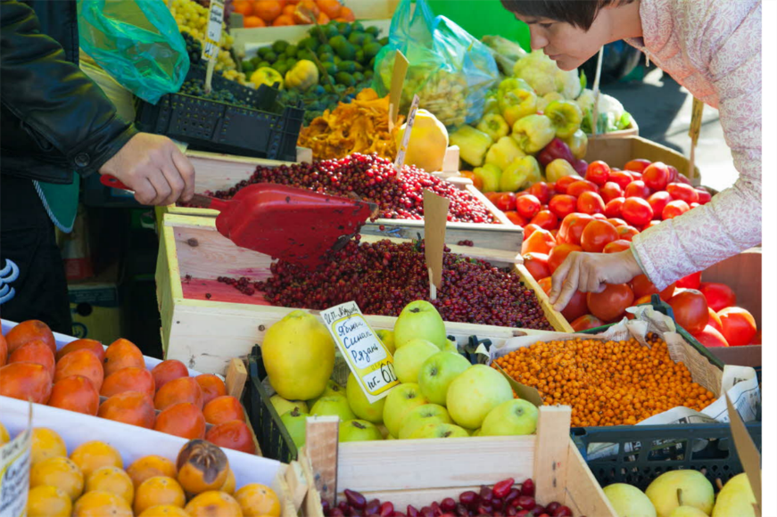
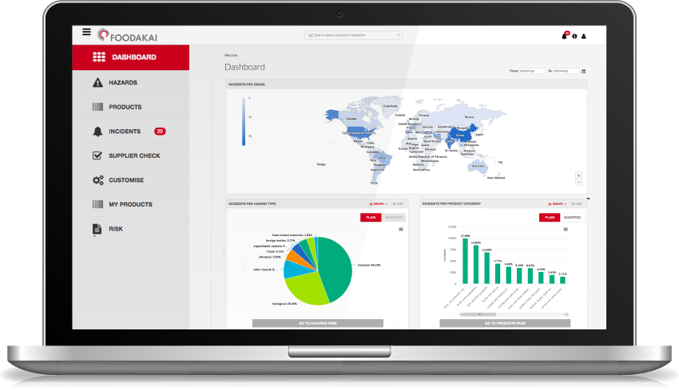
Business & innovation database
Dutch SME is looking for partners in the fruit industry to validate their new device to assess the shelf life quality & contaminants in fruits and vegetables
POD Reference TRNL20200527001
The solution can screen produce such as fruits and vegetables for shelf life and contaminants (like pesticides, antibiotics, pathogens )
Leading Greek IT company offers free access to global food safety platform to ensure safe food for all during challenging times
POD Reference BOGR20200323001
The platform supports the food industry to quickly respond to major health crises like the Covid-19
een.ec.europa.
https://een.ec.europa.eu/partners

Slide 5



Slide 6
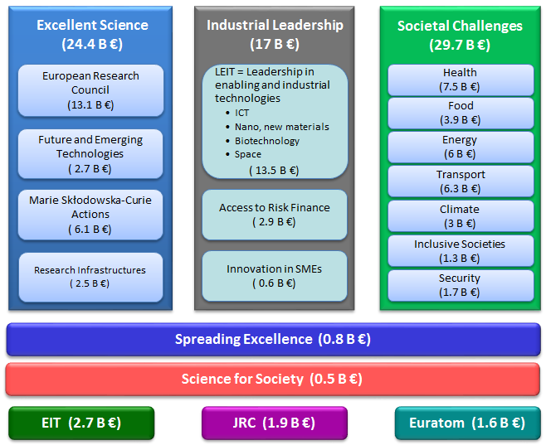
What is Horizon 2020 & Horizon Europe
Consortia 3Χ3
3 organisations (SMEs Included) from 3 Countries (ΕΕ & affiliated) Minimum
Moving to Horizon Europe
the next Framework programme

Slide 7
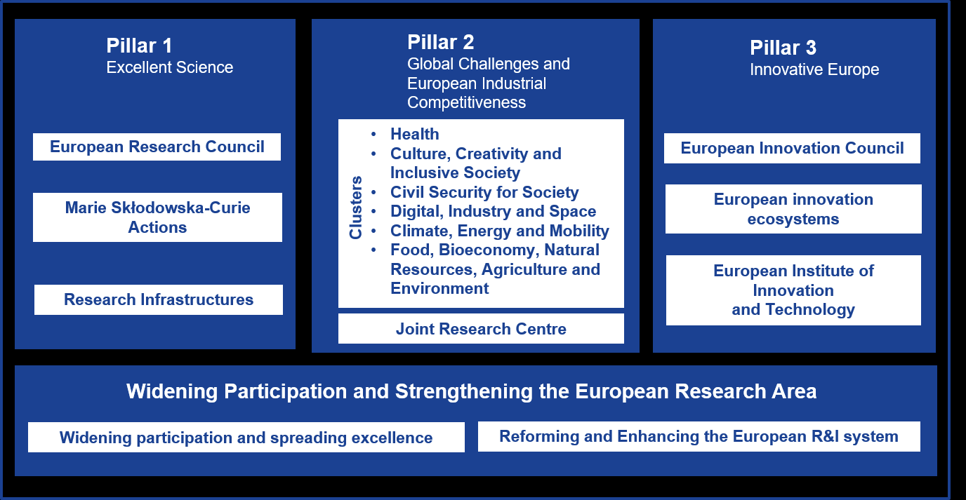
What is Horizon Europe

Slide 8

The European Innovation Council focus on: the EIC Accelerator

Slide 9
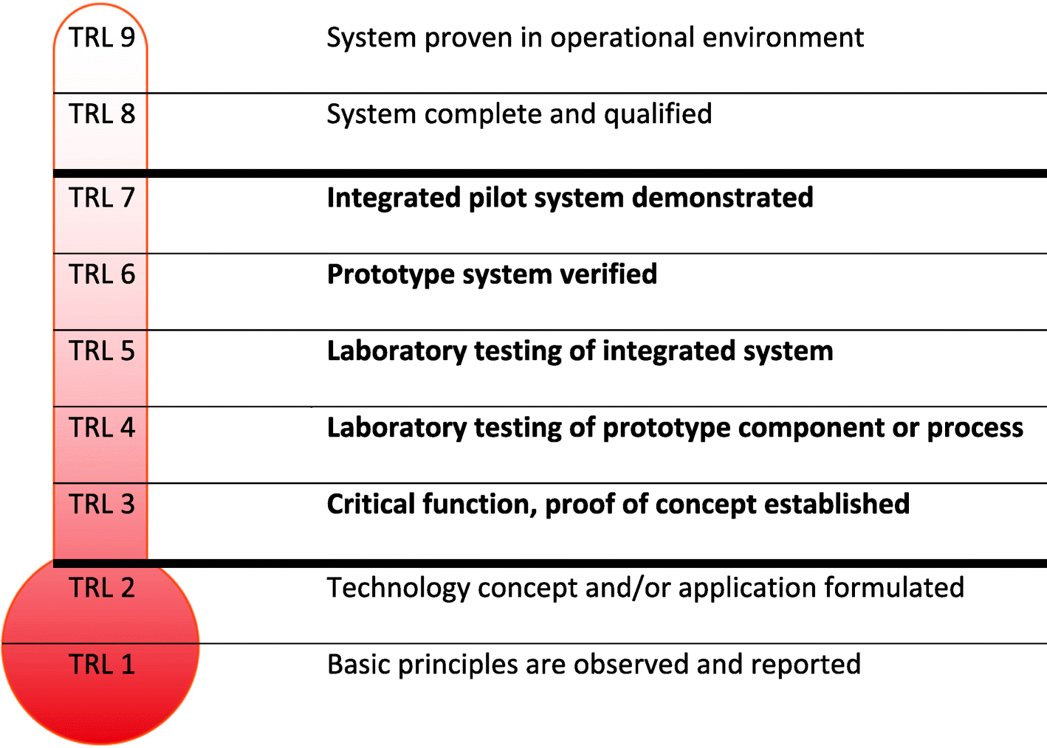
Technology Readiness Levels
Technology Readiness level 6: Technology system or subsystem model or prototype demonstration in a relevant environment

Slide 10
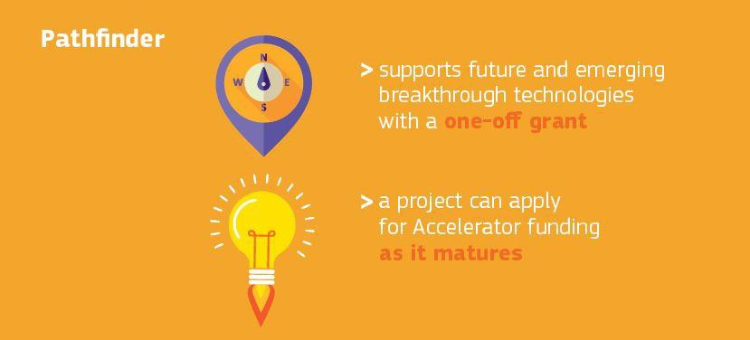
The EIC Pathfinder

Slide 11
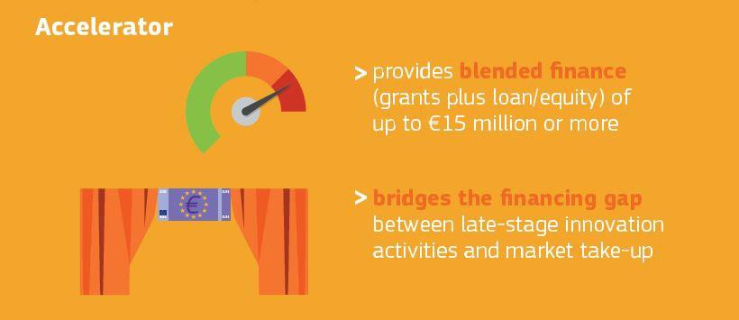
The EIC Accelerator

Slide 12


Accelerator- former SME Instrument Blended (Grant + Equity)
Individual SMEs targeting new market with
high-risk, high-growth potential
Bottom up: all sectors
Single template for 2 option | if you are requesting Equity you need to complete extra forms for the due diligence process
Grant € 0,5- € 2,5 mi. (funding rate 70%)
All activities including commercialisation
12-24 months (TRL > 6)
Equity:
Up to €15 million, EC % < 25%
Activities above TRL 8 (mature solutions)

Slide 13
Accelerator Pilot (grant or grant + equity) Novelties
Evaluation: award criteria
Three award criteria:
33% 'impact‘
33% 'excellence'
33% 'quality and efficiency of implementation'
In addition, the equity component will be subjected to
due diligence by the EC FUND .
Time-to-inform: 3 months
Time-to-grant
Grant-part: 6 months
Equity part: +3 months

Slide 14
Fast Track to Innovation – FTI
Fast go-to-market of an industry-driven, innovative
concept to grow and scale-up.
Co-creation and open innovation.
Grant-only
Bottom-up
Consortia of 3-5 — mandatory industry involvement
Up to €3 million
36 months
Fast Track to Innovation – FTI

Slide 15
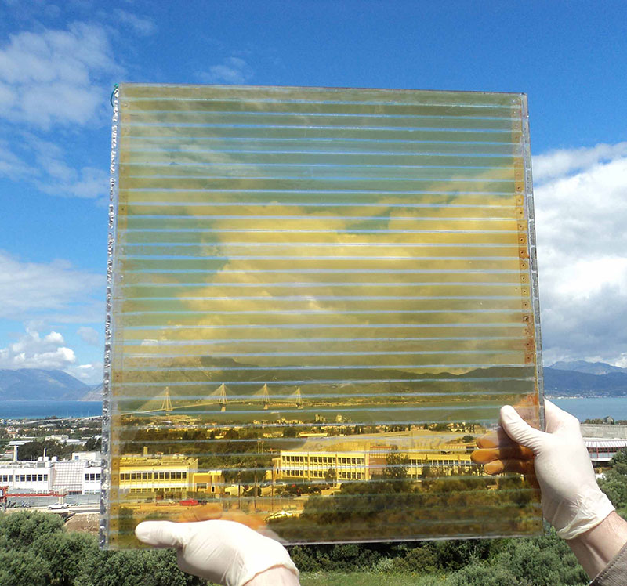
EIC Accelerator, Success Stories
PanePowerSW:
Transparent Photovoltaic Panels
για Ενεργειακά αυτόνομα Θερμοκήπια και Γυάλινα Κτίρια. For Autonomous Green Houses and Glass buildings.
Company: Brite Solar

Slide 16
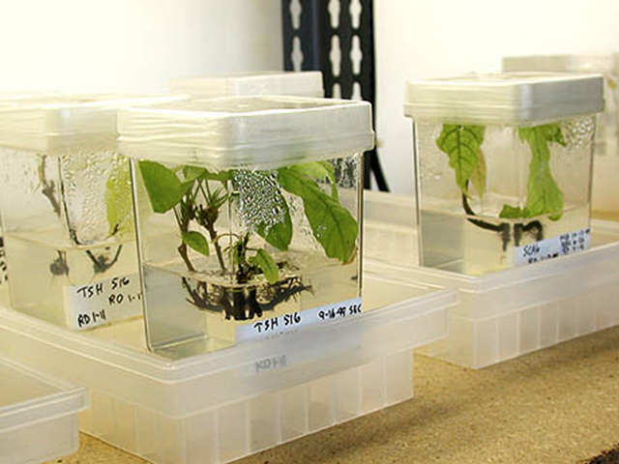
EIC Accelerator, Success Stories
PanePowerSW:
COCOA In Vitro PROpagation
Demand for cocoa is on the rise, Micropropagation has emerged as an important global agro-technology routine used for rapid generation of high quality, uniform and disease-free planting material.
The SME can answer the increase on demand by presenting a maximum production capacity of:
1 million cocoa plants and a net profit of €600,000, enable a corporate growth of a total net profit of €1,200 million by 2020.
Company: CocoaPro

Slide 17

A European Green Deal

Slide 18
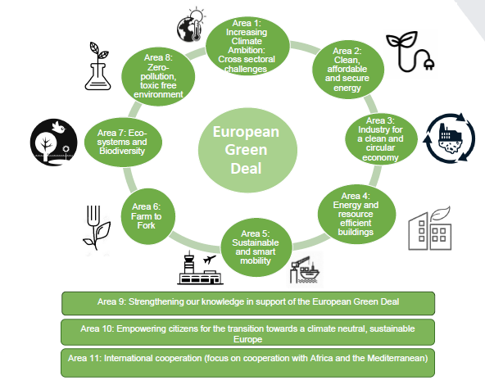
The European Green Deal
Notes:
boost the efficient use of resources by moving to a clean, circular economy
restore biodiversity and cut pollution

Slide 19
The European Green Deal goals
Make the EU climate neutral by 2050
Restore biodiversity and cut pollution
Invest in environmentally-friendly technologies
Support the industry in innovating
Boost the efficient use of resources
Move to a clean, circular economy
Roll out cleaner, cheaper and healthier forms of transport
Decarbonise the energy sector
Ensure buildings are more energy efficient
Work with international partners to improve global environmental standards
Notes:
boost the efficient use of resources by moving to a clean, circular economy
restore biodiversity and cut pollution

Slide 20





From Farm to Fork
A healthier and more sustainable EU food system is a cornerstone of the European Green Deal
2030 targets:
reduce the use of chemical and more hazardous pesticides by 50%
reduce nutrient losses by at least 50%, reduce fertilizer use by at least 20%
reduce the sale of antimicrobials for farmed animals & inaquaculture by 50%.
25 % of total farmland being used for organic farming by 2030.
Notes:
boost the efficient use of resources by moving to a clean, circular economy
restore biodiversity and cut pollution

Slide 21
The European Green Deal H2020 Calls
Preventing and fighting extreme wildfires with the integration and demonstration of innovative means LC-GD-1-1-2020
Towards Climate-Neutral and Socially Innovative Cities LC-GD-1-2-2020
Climate-resilient Innovation Packages for EU regions LC-GD-1-3-2020
Building and renovating in an energy and resource efficient way LC-GD-4-1-2020
Green airports and ports as multimodal hubs for sustainable and smart mobility LC-GD-5-1-2020

Slide 22
The European Green Deal H2020 Calls
Testing and demonstrating systemic innovations in support of the Farm-to-Fork Strategy LC-GD-6-1-2020
Restoring biodiversity and ecosystem services LC-GD-7-1-2020
Innovative, systemic zero-pollution solutions to protect health, environment and natural resources from persistent and mobile chemicals LC-GD-8-1-2020
Fostering regulatory science to address combined exposures to industrial chemicals and pharmaceuticals: from science to evidence-based policies LC-GD-8-2-2020
Transparent & Accessible Seas and Oceans: Towards a Digital Twin of the Ocean LC-GD-9-3-2020

Slide 23
LC-GD-6-1-2020: Testing and demonstrating systemic innovations for sustainable food from farm to fork: IA, 74 million, 6-4 million per project, TRL 5-7
Proposals should pay particular attention to:
Apply system thinking/approaches to define the challenge
Multi-actor & cross-sectoral approach to co-create, test and demonstrate solutions from production to consumption
Include appropriate mix of innovations, such as:
Novel digital and space based technologies(EGNSSand Copernicusdata and services)
New business, supply chain, goverancemodels
Ecological and social innovations
Focus on upscaling innovations(TRL 5-7), can include limited research
Understand behaviors, motivations and barriers, to maximize the uptake of solutions
Take into account the EU market regulatory frameworks(e.g. safety, environmental)
Where appropriate,capitalize on existing testing and demonstration facilities
Deliver and implement action plan for dissemination,communication and engagement,
International cooperation is encouraged.
Notes:
boost the efficient use of resources by moving to a clean, circular economy
restore biodiversity and cut pollution

Slide 24
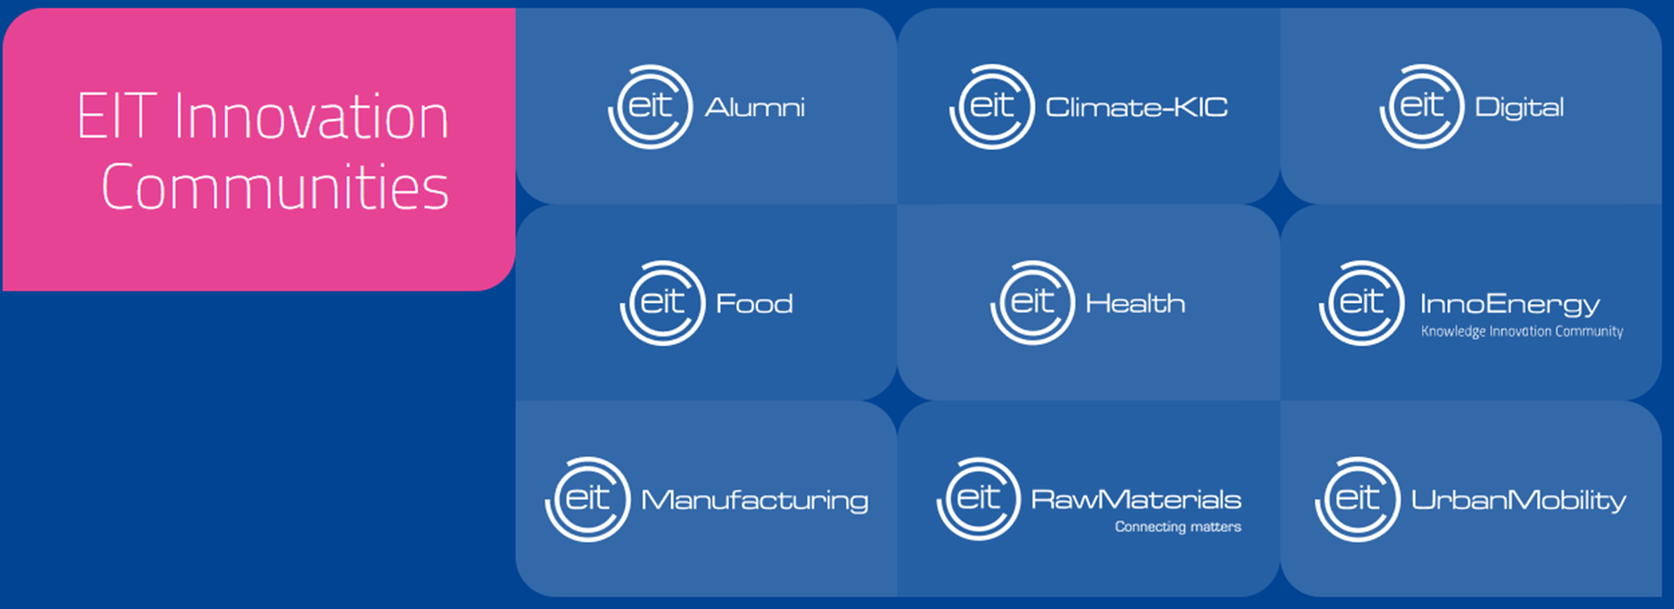
European Institute of Innovation & Technology – Knowledge Innovation Communities EIT KICs & HUBs

Slide 25
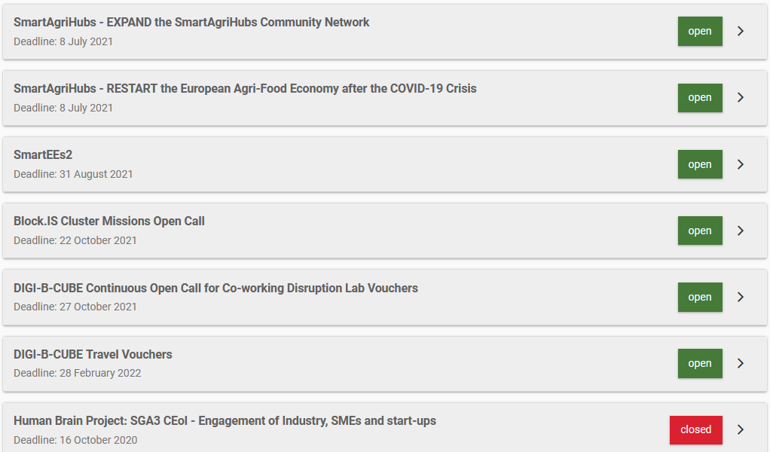
Cascading Grants (FSTP) – Other competitive calls like farm2fork! In H2020
https://ec.europa.eu/info/funding-tenders/opportunities/portal/screen/opportunities/competitive-calls

Slide 26
European Institute of Innovation & Technology – Knowledge Innovation Communities EIT KICs & HUBs

Slide 27
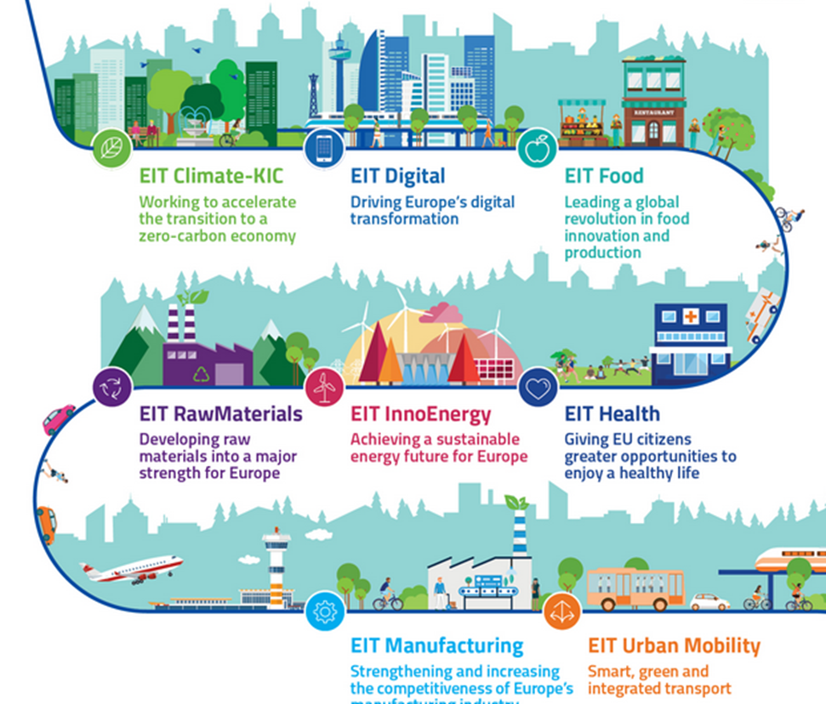
EIT KICs & HUBs

Slide 28
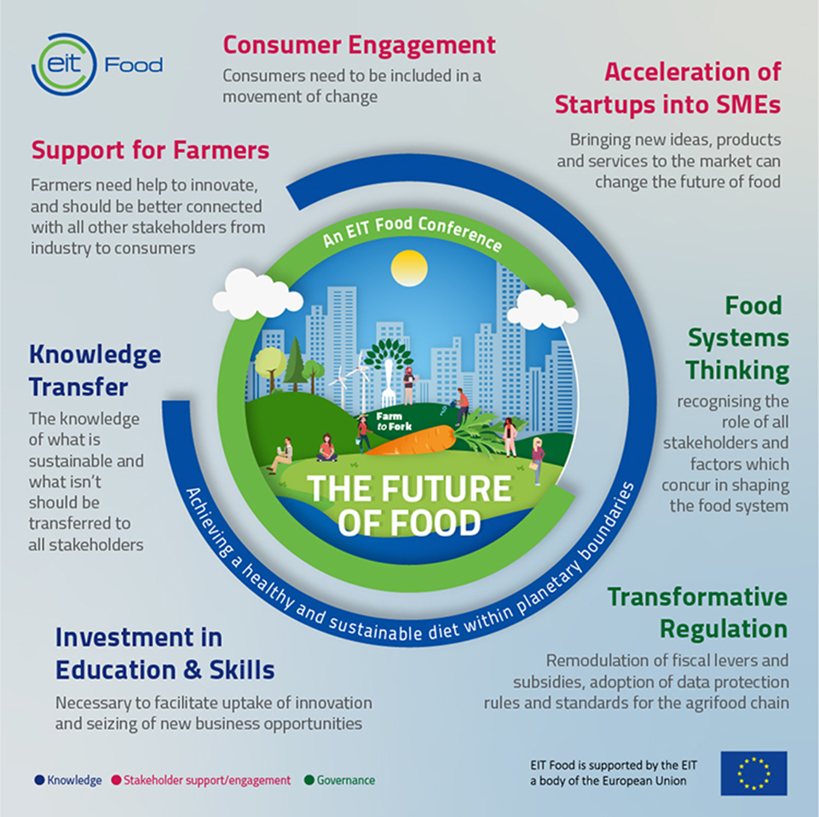
EIT Food

Slide 29
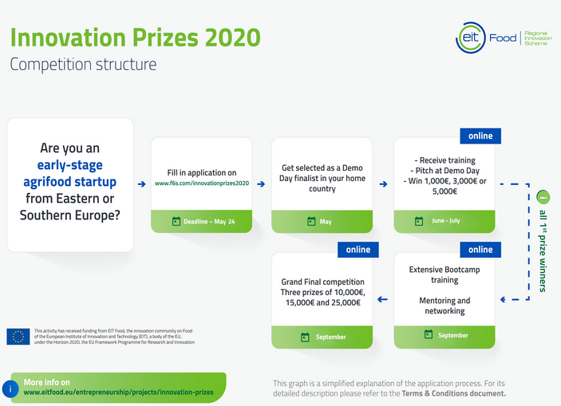
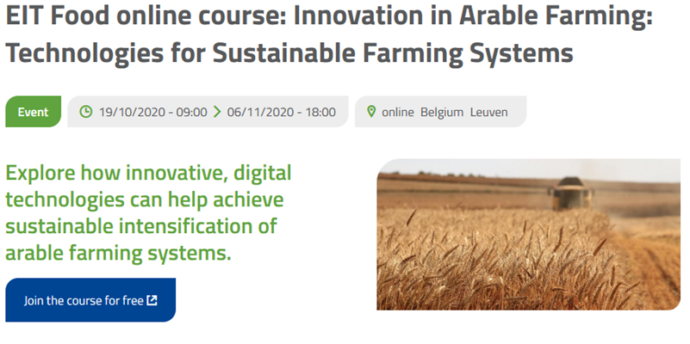
EIT KICs & HUBs
EIT Food
Innovation
Education
Applications now closed! February 4 - May 24 via F6S website

Slide 30
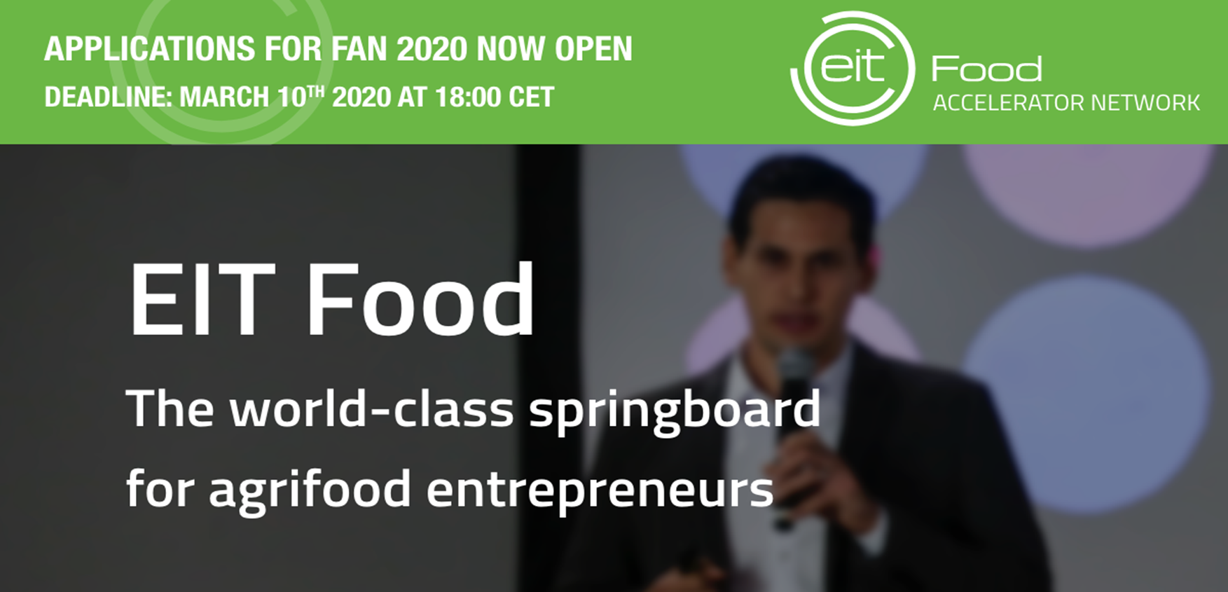




EIT KICs & HUBs
EIT Food
Entrepreneurship/Acceleration
EIT Food Accelerator Network
The EIT Food Accelerator Network (FAN) is an accelerator programme delivered across Europe, supporting high impact agrifood startups to maximise their success

Slide 31

EIT Health

Slide 32
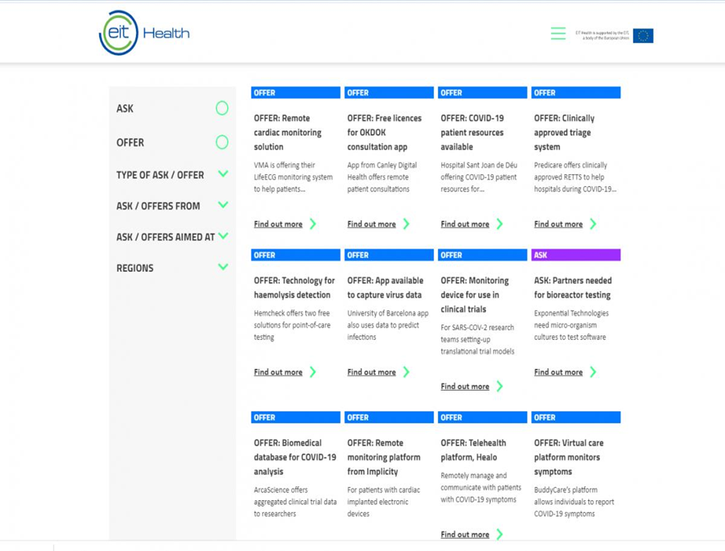
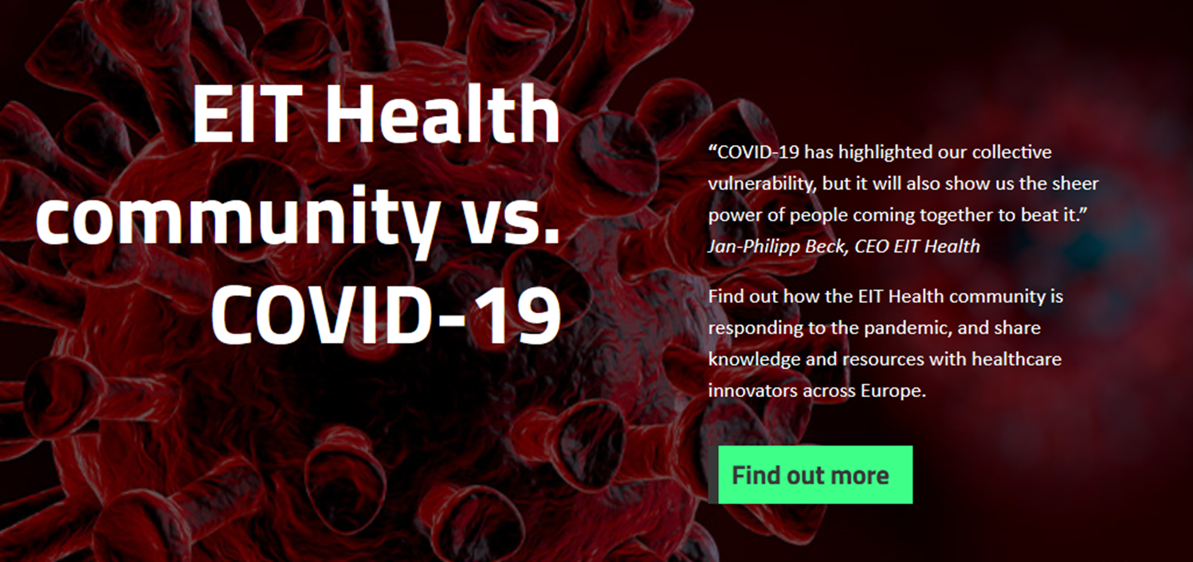
EIT Health Covid Matchmaking platform
Upload your own solution against COVID here: https://eithealth.eu/fighting-covid-19/
Connecting Needs with Innovative Solutions

Slide 33
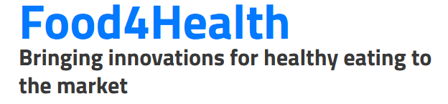

EIT Health & EIT Food:
Food4Health, a collaboration between EIT Health and EIT Food, was established to help bring innovations for healthy eating to the market
Projects:
STOP MetSyn – Using Indicators to Influence Consumer Behaviour and Prevent Pre-Disease Through Food and Lifestyle-related Interventions
MuscleCancer – Tackling Muscle Mass Loss in Cancer Patients Through Nutrition Solutions and Lifestyle Interventions

Slide 34
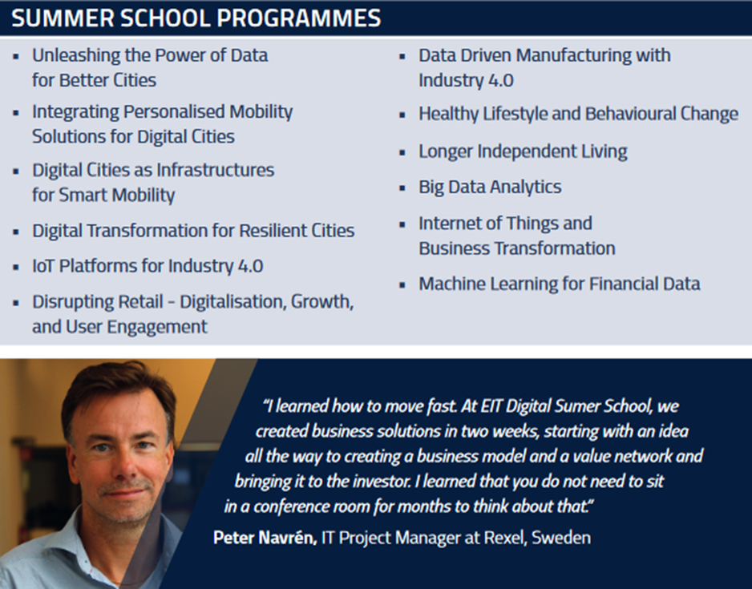
EIT Digital

Slide 35
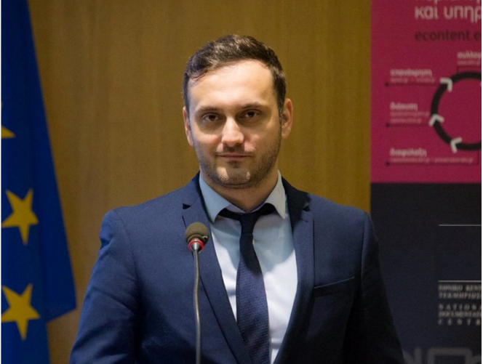
Thank you for your attention!
megas@ekt.gr
+30 6982612266

