Slide 1
Farm to Form Hackathon introduction and Session #1
Daniel Copot, DIH AGRIFOOD manager

Slide 2
Agenda
Mentoring programme introduction
Session #1:
DIH AGRIFOOD support services
Farm2Fork hackathon process
Benefits for Startups/SMEs and steps to be taken

Slide 3


















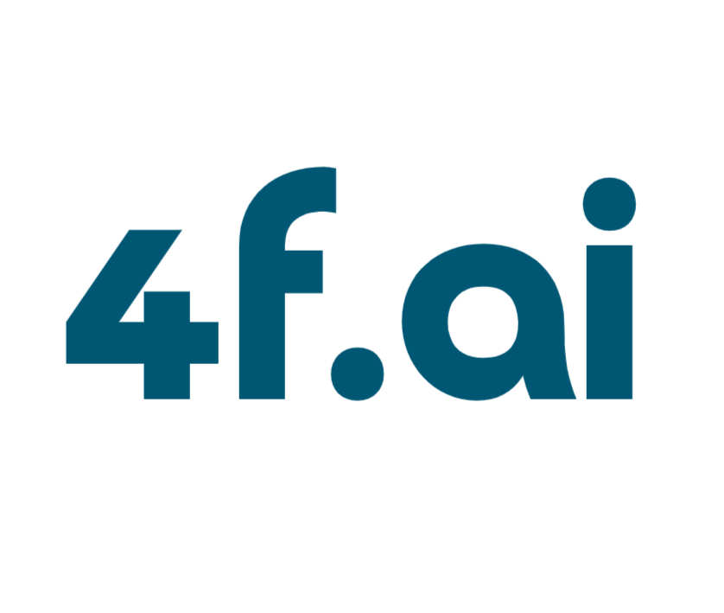









Welcome participants (28)!

Slide 4
Open call results and Clarification!
20 chosen for the F2F Hack competition (pitching)
6 on the reserve list
2 non-eligible but participating (countries outside EU)

Slide 5
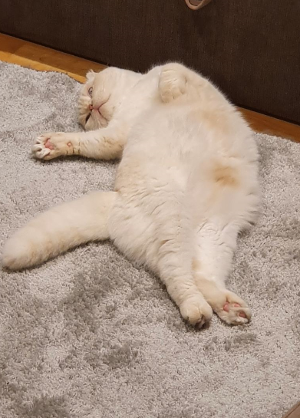
Few pointers to start with!
Let‘s learn from each other
Let‘s build new collaborations
Let‘s interact (camera on, chat/Q)
Move from the ‘‘comfort zone‘‘
Any reservations about publishing/promoting activities?

Slide 6
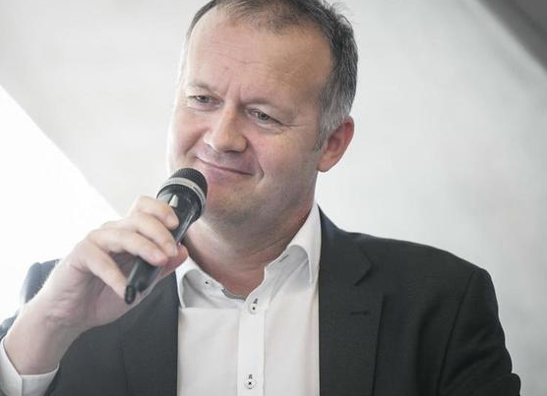
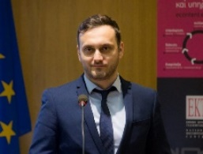

Mentoring programme
Session #1: Introduction, DIH AGRIFOOD support services and F2F Hack process session
Session #2: Commercialization and Networking session
Session #3: Pitching preparation session

Slide 7
SESSION #1: DIH AGRIFOOD SUPPORT SERVICES

Slide 8

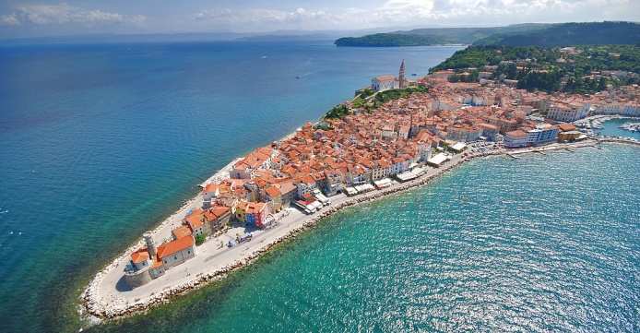
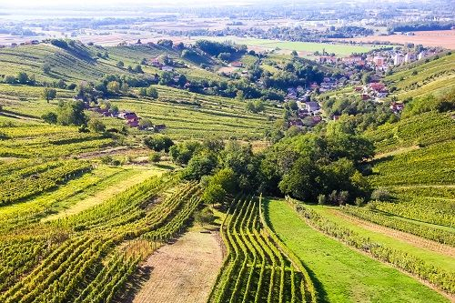
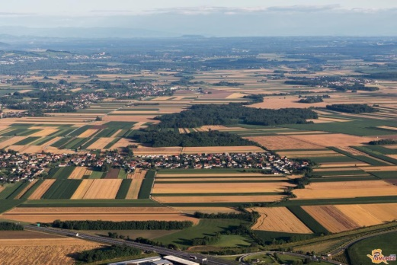

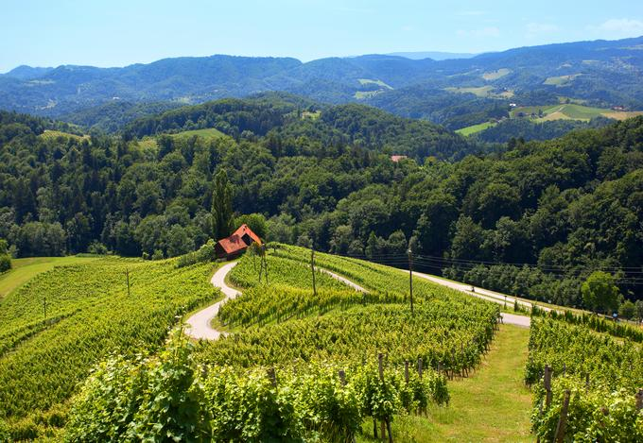
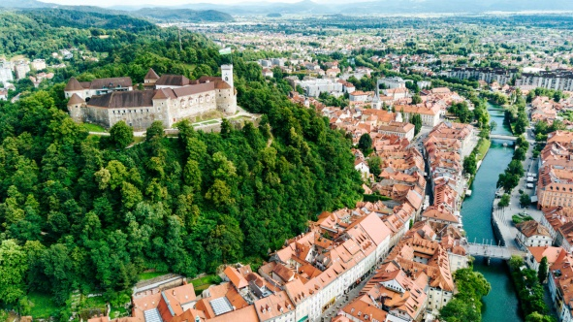


ITC - Innovation Technology Cluster
ITC Cluster aims at fostering cross-sectoral innovation, based upon novel technologies and ICT, while bringing together SMEs and other institutions from different sectors and turn them into being ‘’Smart’’
Technology Transfer office
The Technology Transfer skills and principles are the key for ITC cluster operation

Slide 9
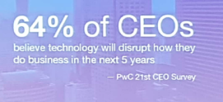
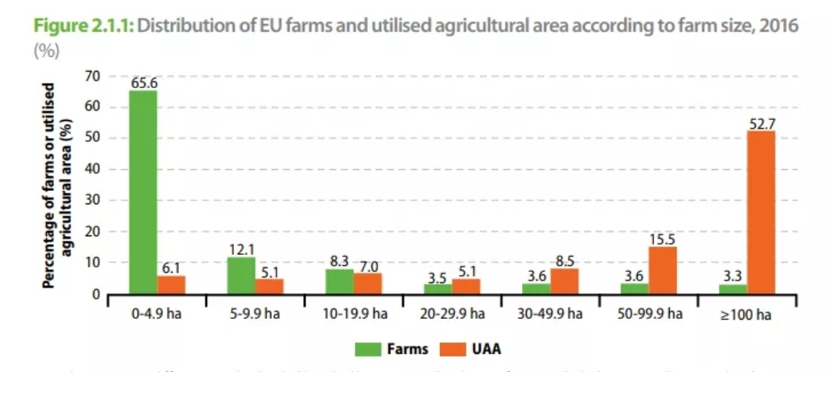
We needed to support farmers differently!
WHY? We need to produce more food with less resources and the way to achieve this is through digital transformation
Technologies: IoT, IoE, Industry 4.0, Agriculture 4.0
Trends in EU (Common EU Agricultural Policy, EIP-AGRI)
Farmers should be put in the centre!
The importance of ‘‘Technology transfer‘‘
Living lab approach
Complexity, lack of skills, lack of finances, …

Slide 10
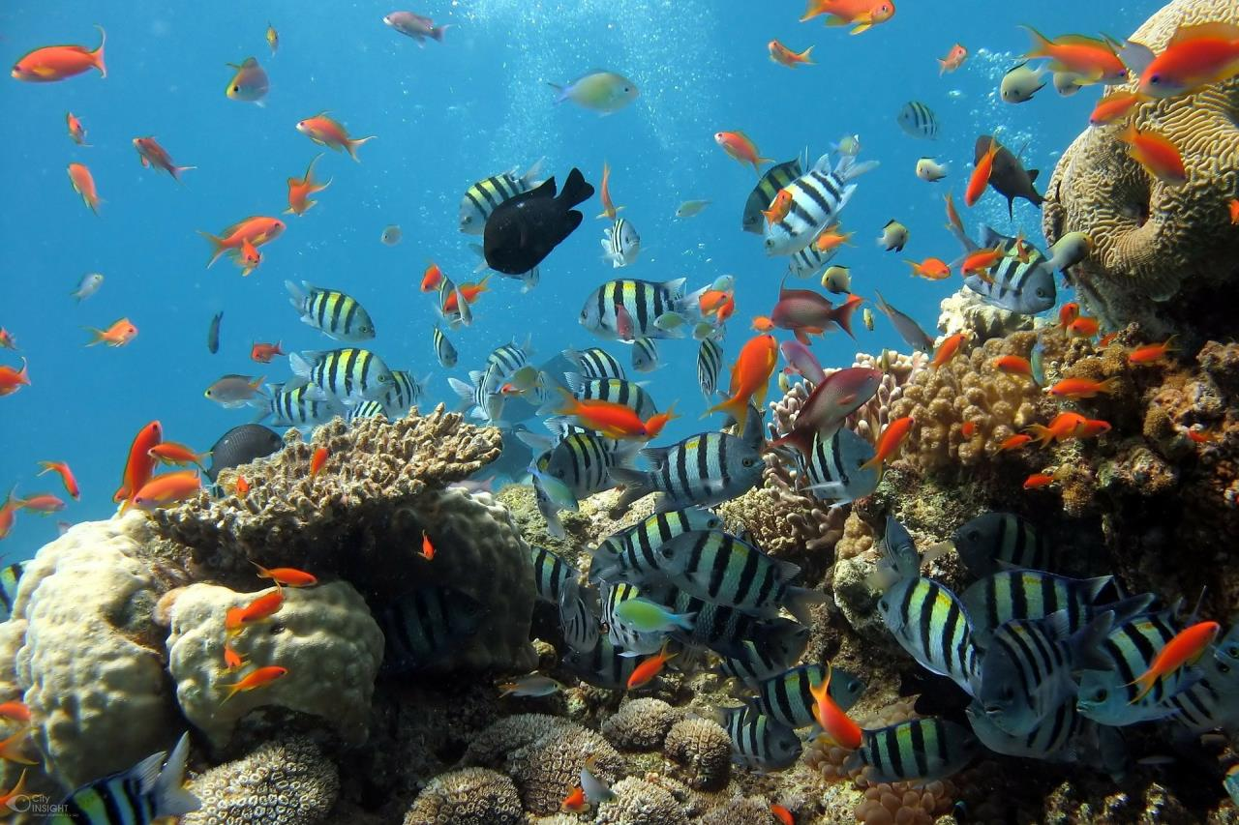
Digital Innovation Hub for Agriculture and Food Production – DIH Agrifood
The organization should represent a One-Stop-Shop providing services to target groups (farmers and food producers) through a multi-partner cooperation
The DIH ecosystem can be seen as a coral reef where there are big and small fish, hunters and prey, but overall everyone performs better compared to isolation.”
— Grigorios Chatzikostas, EIP-AGRI Seminar
Digital Innovation Hubs for Agriculture

Slide 11
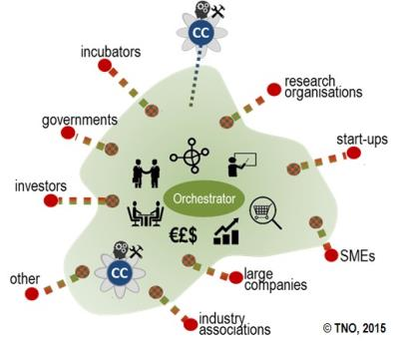

We needed to support farmers differently!
Multi-Actor Approach (MAA) based
Non-formal structure – network, no membership
Every participant is able TO TAKE ‘‘the common asset‘‘, however they should also be able to CONTRIBUTE to ‘‘the common asset‘‘
DIH AGRIFOOD shall become the synonym for Digital transformation of farmers and food producers
KISS (Keep it Simple and Smart)

Slide 12
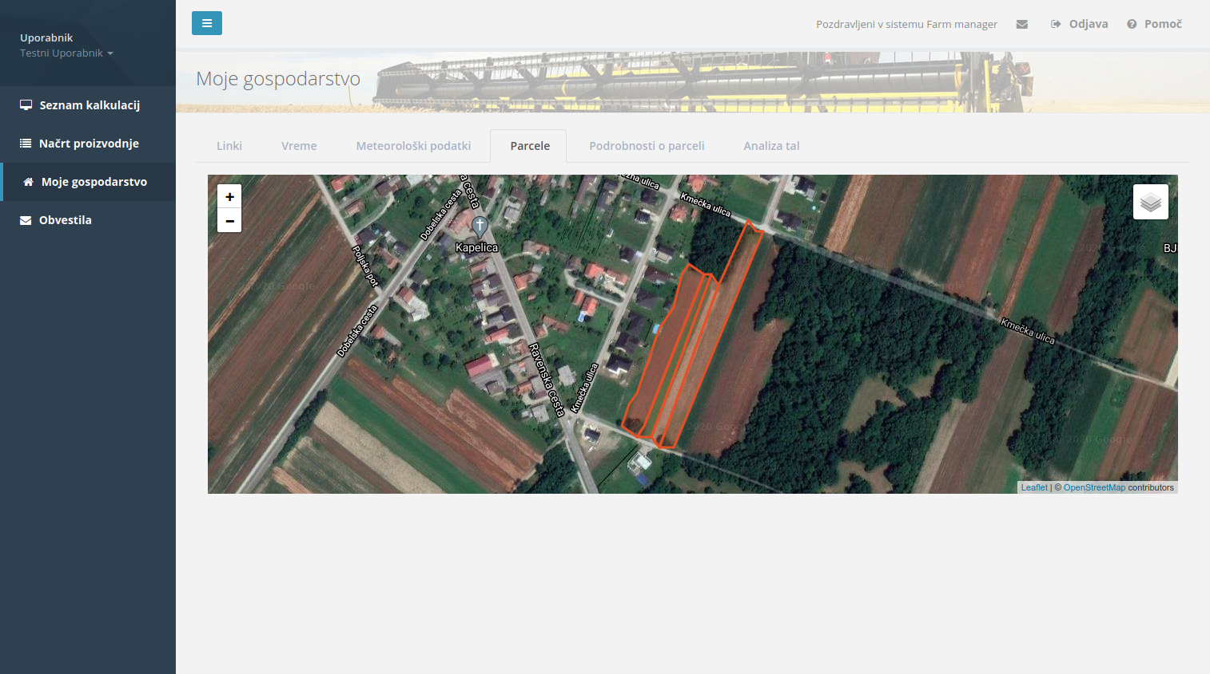



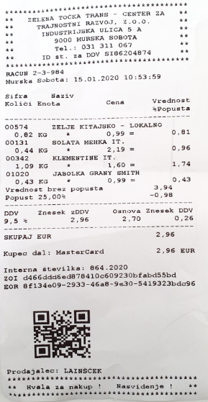
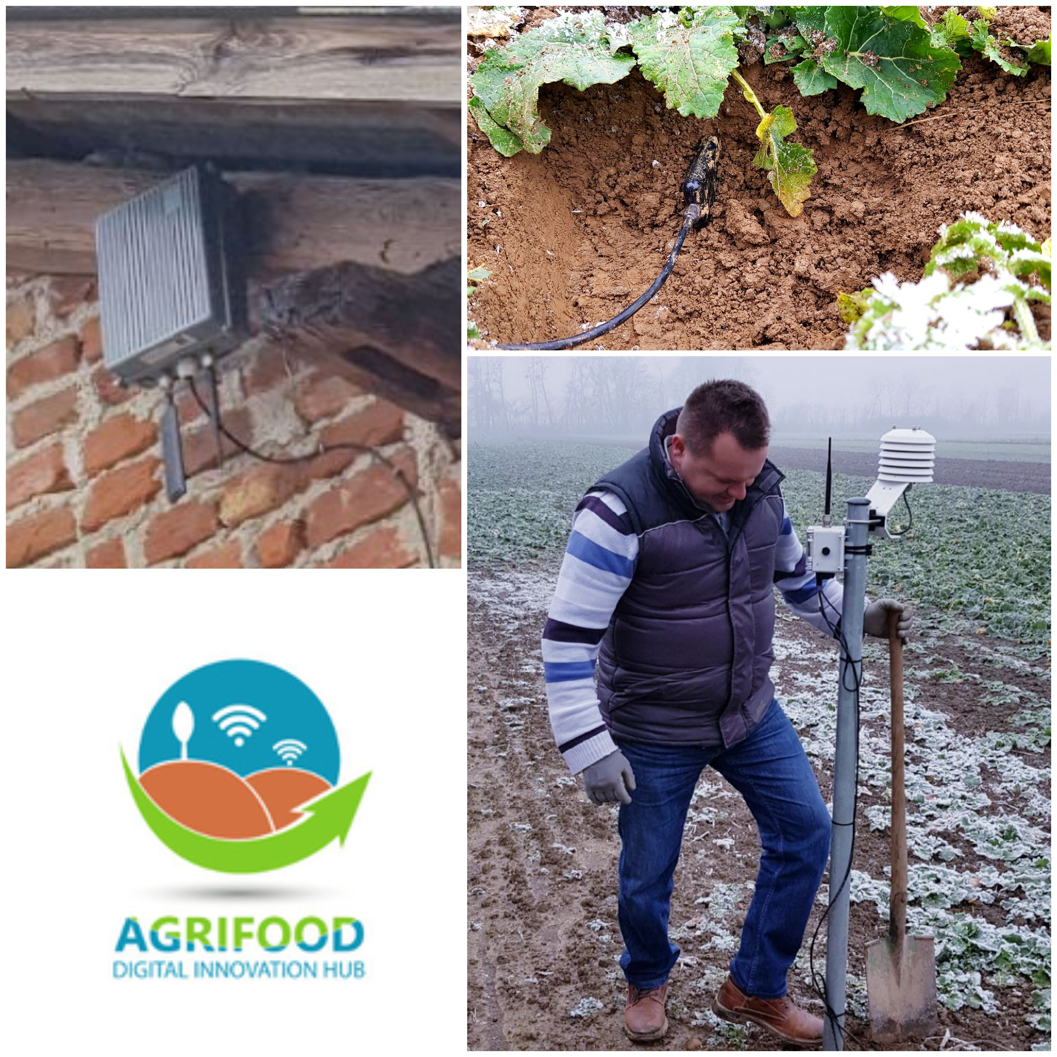
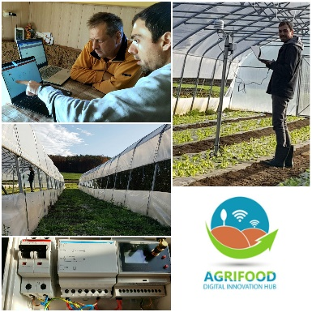
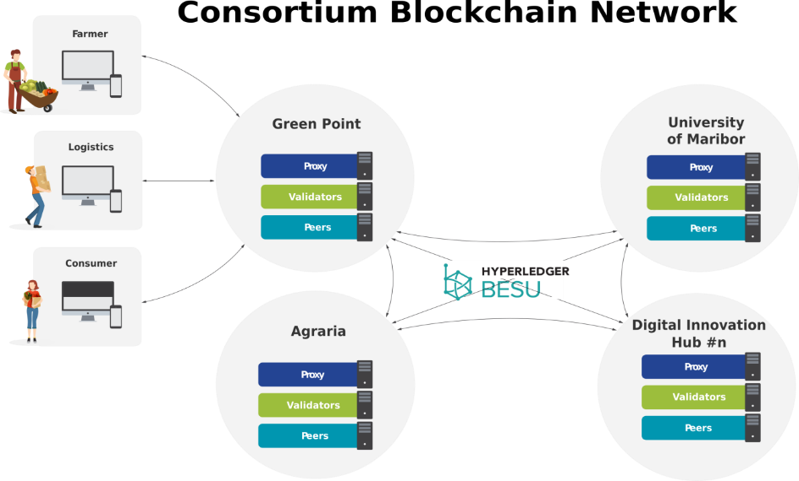
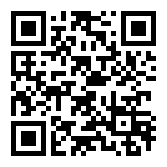
Important role of DIH!
Establishing DIH AGRIFOOD IT infrastructure, which will be composed of a set of technology specific services and enablers, allowing Startups/SMEs and other stakeholders to ease the exploitation of modern ICT technologies, based on: Open access, Privacy and Data ownership

Slide 13

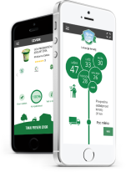


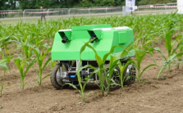
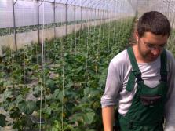

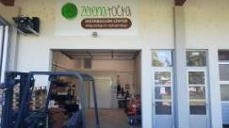
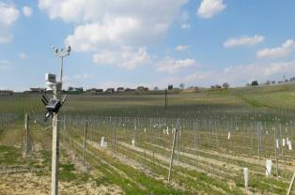
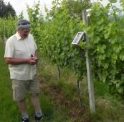
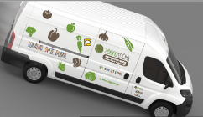
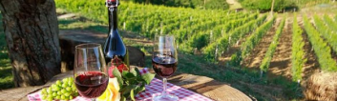
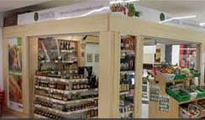
DIH AGRIFOOD - thematic areas
Gastronomy
Digital transformation
Short supply chains

Slide 14















DIH AGRIFOOD service portfolio
Living lab
Awareness creation
Mentoring and training
Innovation scouting and Technology Transfer
CYSLOP
Develop strategies and business models
Cooperation with other DIHs
Financing / funding

Slide 15

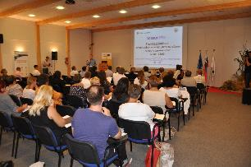
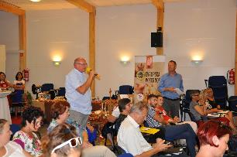
DIH AGRIFOOD services
Awareness creation around digital technologies is highly important for the farmers.
The key questions: Why should somebody implement new technologies? What are the benefits, threats and challenges?
Activities: events, conferences, B2B meetings, communication and dissemination

Slide 16

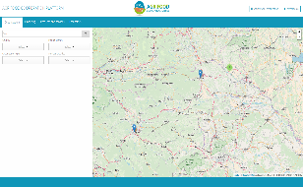
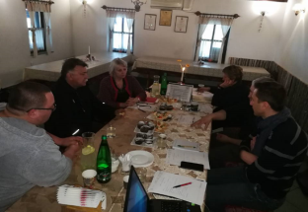
DIH AGRIFOOD services
There are all sort of technologies already available to take and implement.
The key question: How could we
effectively identify and manage as
many existing technologies
as possible?
Activities: use of mapping tool, scouting, B2B meetings, networking

Slide 17

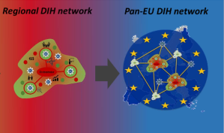
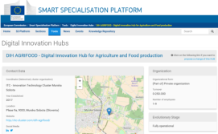


DIH AGRIFOOD services
Collaboration with other DIHs is a key for more efficient technology transfer – ‘‘clustering clusters‘‘.
The key questions: How could we increase our reach as efficiently as possible? Are there other DIHs/HUBs that operate similarly?
Activities: international projects, networking and partnership agreements, use of common tools and methodologies

Slide 18






DIH AGRIFOOD services
Farmers need financial support for digital transformation.
The key questions: How could we motivate farmers to adopt new technologies faster? Why should they take the risk of unknown (and costly)?
Activities: access to funding through European projects and cascade funding opportunities

Slide 19

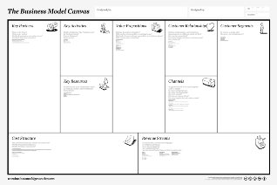

DIH AGRIFOOD services
Farmers need to understand which technology to take and why.
The key question: How to choose the right technology and why? What are the economic benefits for the farmer?
Activities: Strategy and business model development

Slide 20

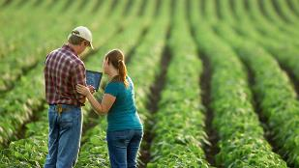
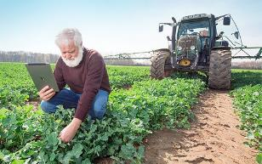
DIH AGRIFOOD services
Farmers need new ways of mentoring and training about how technologies will change their life and work.
The key question: How can we achieve that farmers understand the complex world of technologies and their benefits?
Activities: Developing training material and conducting training sessions

Slide 21

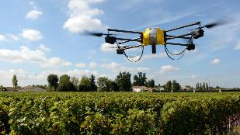
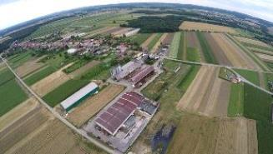
DIH AGRIFOOD services
Farmers believe only if they can see it and feel it!
The key question: How can we show
how new technologies work and make farmers believe it is really working?
Activities: Demo implementations, dissemination and communication,
demo site visits

Slide 22
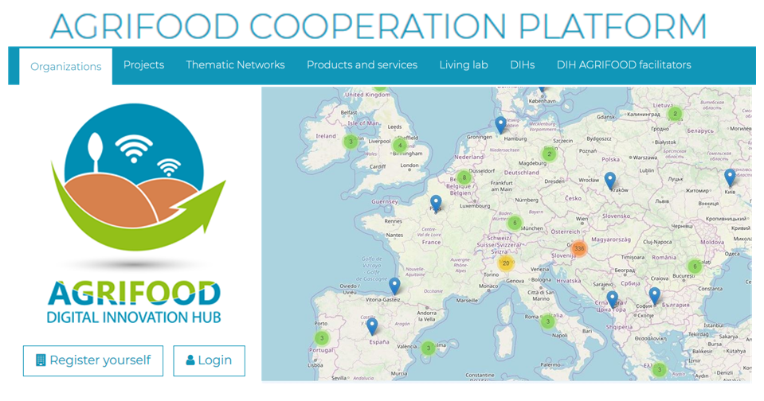
DIH AGRIFOOD Network
The COLLABORATION and NETWORKING platform, based on FACILITATION, hosting:
Organizations >800, reaching>6.000
Projects >25 projects
Thematic Networks 2 TN
Products and Serv. >150 P/S
Living lab >20 Living Labs
DIHs >50 DIHs
SME/Startup support >80 support organiz.
Facilitators >20 from 7 countries
WELCOME TO REGISTER!
https://mapping.dih-agrifood.com/

Slide 23
DIH AGRIFOOD Facilitation
The importance of facilitation!
Understanding farmer‘s needs
Connecting Supply and Demand
Skilled in Technology transfer process
Being able to facilitate the digital transformation process
Being able to get financial support
Excellent Demonstrators, Promotors
WELCOME TO REGISTER!
https://mapping.dih-agrifood.com/

Slide 24
SESSION #1: FARM2FORK HACKATHON PROCESS

Slide 25

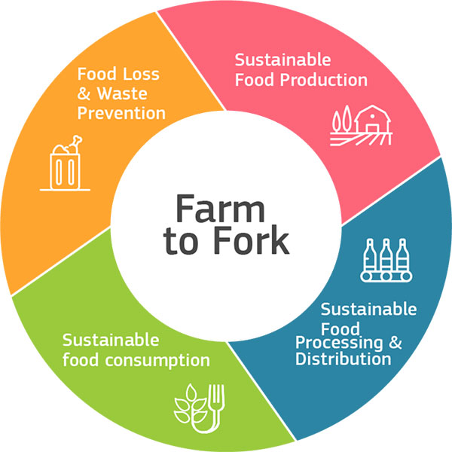
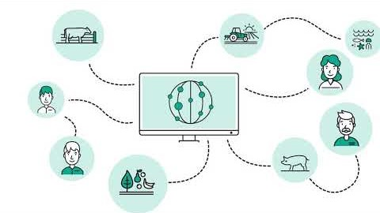
Farm2Fork Hackathon
Hacking sustainable, safe and environmentally friendly food production and supply in SEE as a fight against pandemic scenariosFarm2Fork hackathon process
The hackathon financed by SmartAgriHubs!

Slide 26
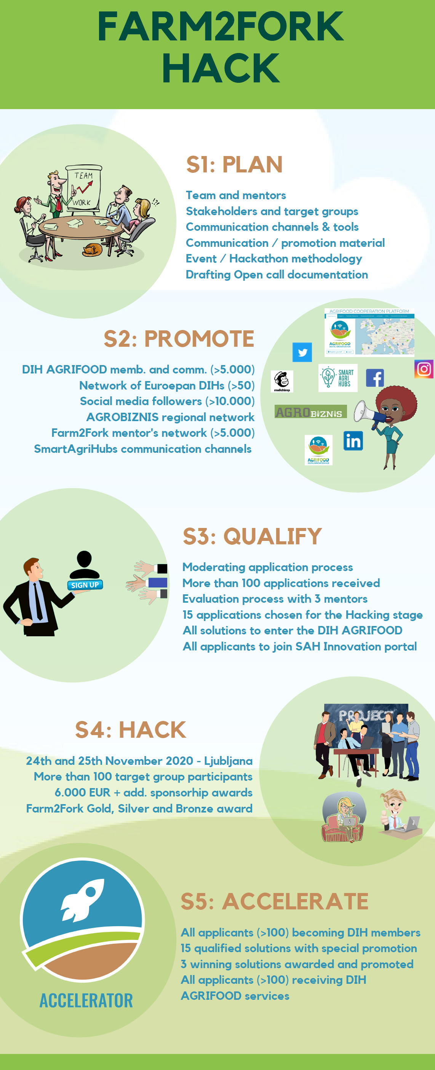



Partners and the process
Partners:

Slide 27
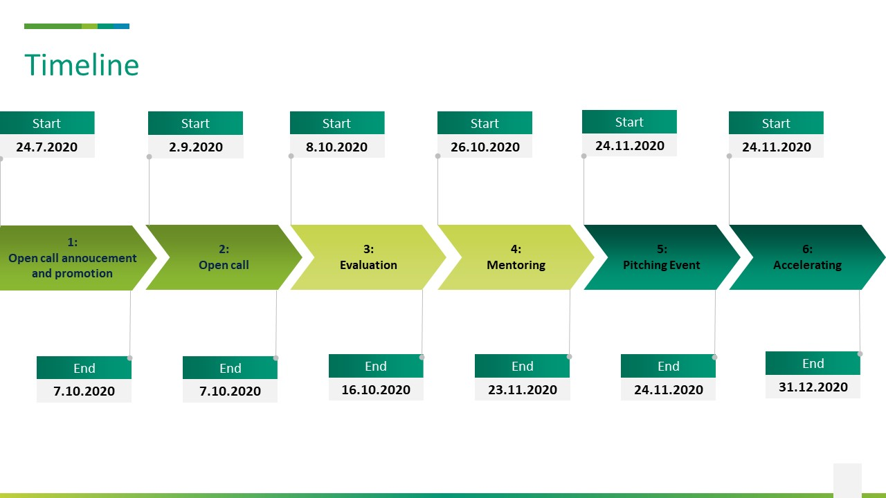
Farm2Fork Hack timeline

Slide 28
Important dates
26.10.2020 (15:00-17:00) – Mentoring session #1
27.10.2020 (9:00-11:00) – Mentoring session #2
12.11.2020 Enterpreneurial Discovery Mission (voluntary for pitching but all invited)
20.11.2020 Individual mentoring sessions (20 min slots)
24.11.2020 F2F Hack conference (Pitching event)

Slide 29
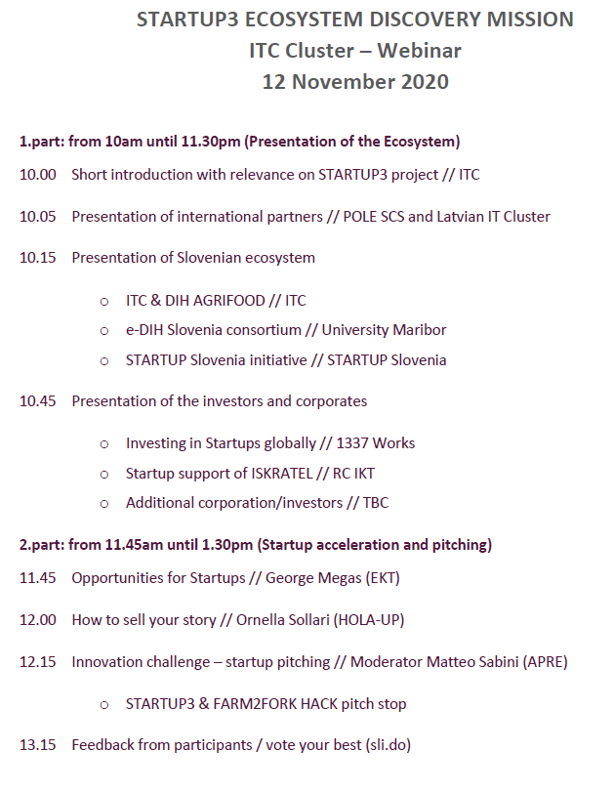

EDM (co-organized with Startup3)

Slide 30
Individual mentoring sessions
20.11.2020 (12:00 – 17:00)
Individual mentoring sessions, 20 mins each!
Focused in pitching and providing feedback – preparing for F2F hack event
Be prepared with Pitch deck (presentation)!
The schedule will follow, with each participant to choose appropriate slot

Slide 31
Farm2Form Hack Conference
13.00 – 13.10 Welcome speech and presentation of the program
13.10 – 13.40 International case of good practice - TBC
13.40 – 13.50 Presentation of the Farm2Fork hackathon
13.50 - 14.45 Farm2Fork Pitching event - 15 finalists
14.55 – 15.30 International case of good practice - TBC
15.30 – 16.00 Announcement of Farm2Fork hackathon winners and Short conversation with the winners

Slide 32
SESSION #1: BENEFITS FOR STARTUPS/SMEs AND STEPS TO BE TAKEN

Slide 33
ACCELERATE activities #1
ALL applicants will be registered and promoted through the DIH AGRIFOOD COOPERATION NETWORK
You will be invited to register at DIH AGRIFOOD platform
ALL applicants have the opportunity to register at the SmartAgriHubs Innovation portal
You will be invited to register at SAH platform

Slide 34
ACCELERATE activities #2
15 qualified solutions will receive special promotion and presentation through a dedicated Article and publishable catalogue of products and services published and promoted through communication channels
You will be invited to prepare/modify your product description for media
3 winning applicants will be announced at the main hackathon/conference event, receive awards and will be interviewed, with their interviews published in the DIH AGRIFOOD and other communication channels

Slide 35
ACCELERATE activities #3 (long term)
All applicants will have the opportunity to get in contact with interested end-users (farmers, industry) and investors for information exchange and collaboration opportunities
Innovation scouting and Technology Transfer, where facilitators will scout your solutions and promote them when possible
Financing/funding, where facilitators will (i) search for additional public funding (ii) connecting solution providers with investors (startup programmes, venture, …)
All applicants will be able to explore/use DIH AGRIFOOD services and access DIH AGRIFOOD infrastructure
Living lab service, through which interested target group members (farmers, food producers, SFSCs) will provide deployment/testing/validation facility for solutions to be piloted and demonstrated to other interested parties. will be presented as Living lab cases (use-cases) at the real user

Slide 36
Thank you for your attention!
daniel.copot@itc-cluster.com
+386 41 343 640

